Slide 1
SE 3330 Course Project Chat App
Group Name: Null Reference Exception
Liam Crain, Austin Fitzgerald, Mitch Vance, Ryan Wolff

Slide 2
Summary
Jira Board
Scenario
Known Bugs
Test Coverage
Issues Encountered
Lessons Learned

Slide 3
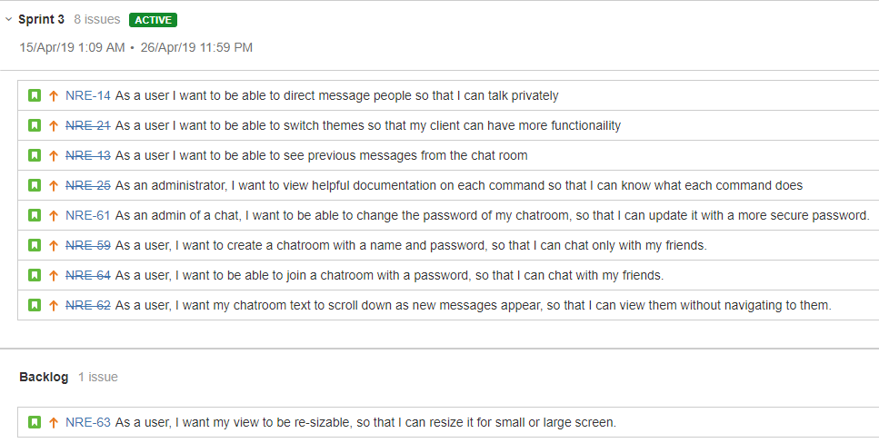
Jira Board

Slide 4
Scenario
Register user
Login user
Logout user
Create chatroom
Join chatroom
Send message
Receive message
Change theme
Undo theme/chatroom

Slide 5
Known Bugs
Previous Bugs:
Showing newly created chatrooms for all logged in users
Sent hashed passwords into chatrooms when password was incorrect
Current Bugs:
None found to date

Slide 6
Test Coverage
Client Coverage
4.19%
Server Coverage
8.82%
Major coverage issues:
NetworkStream and database are unreasonable to unit test due to excess architecture needed
Focus of the project is on data transfer
UI components should not be tested

Slide 7
Issues Encountered
Connecting to SQL server
Network synchronization
WinForms not supporting resizable forms
Unit test coverage for server, databridges, and client functionality

Slide 8
Lessons Learned
Delegating tasks based on ability
Teamwork
C# programming language
Prioritizing tasks
Observer pattern
Layered architecture
Handling changing requirements

Slide 9
Thank You!
Questions/Comments?

